Slide 1
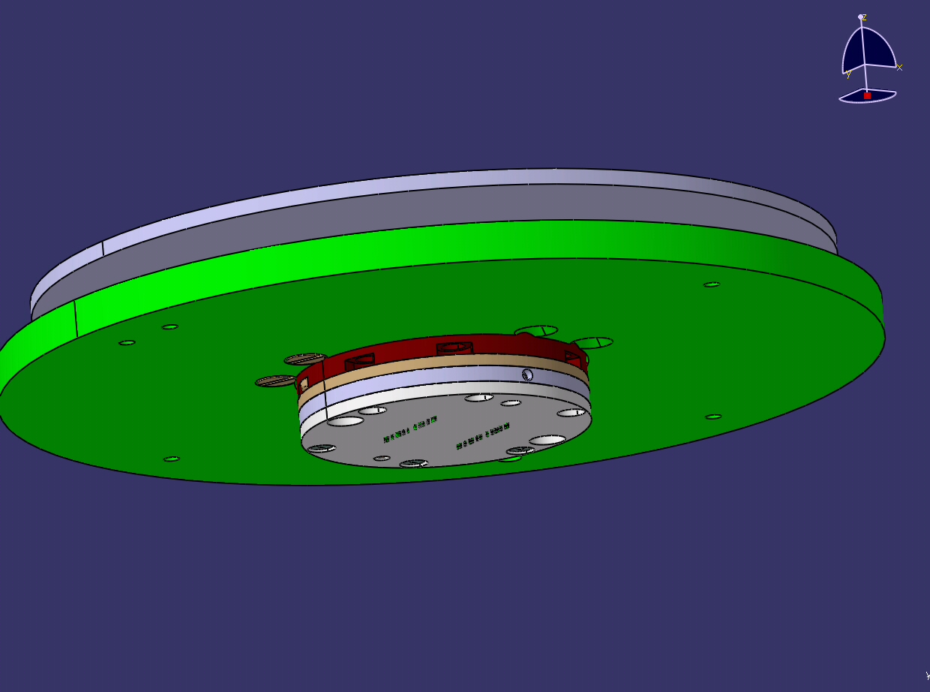
Vertical Probing Technology
Trio™ Probe Card

Slide 2
What is a Vertical Probe Card?
Any medium that translates electrical paths from Die to PCB (Tester Channel).
Ability to Probe Area Array, Flip Chip, Solder Bumps
Ability to Probe Multiple Devices in parallel

Slide 3
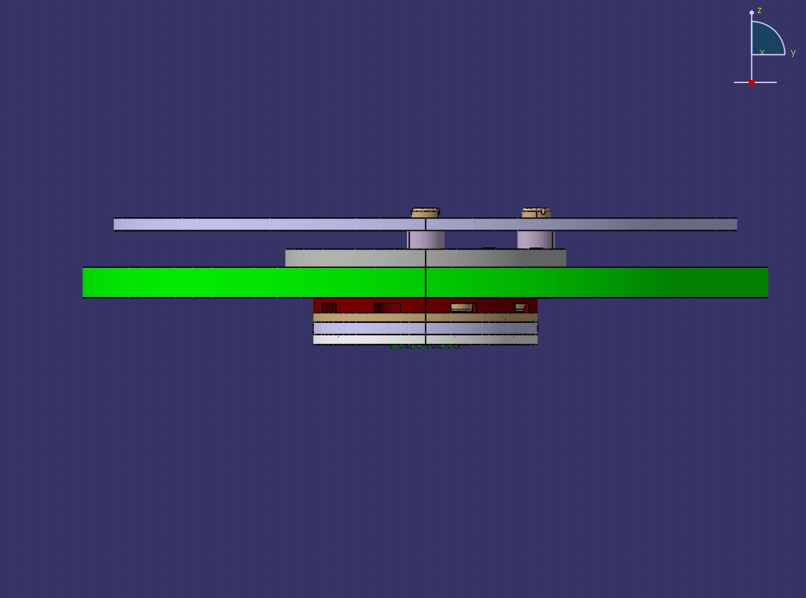

Probe Card Assembly
Space Transformer
Probe Head
Types of Space Transformers used:
  Wired
  Rigid (SV Substrate/ CS Substrate)
  Direct attach/ Modular

Slide 4
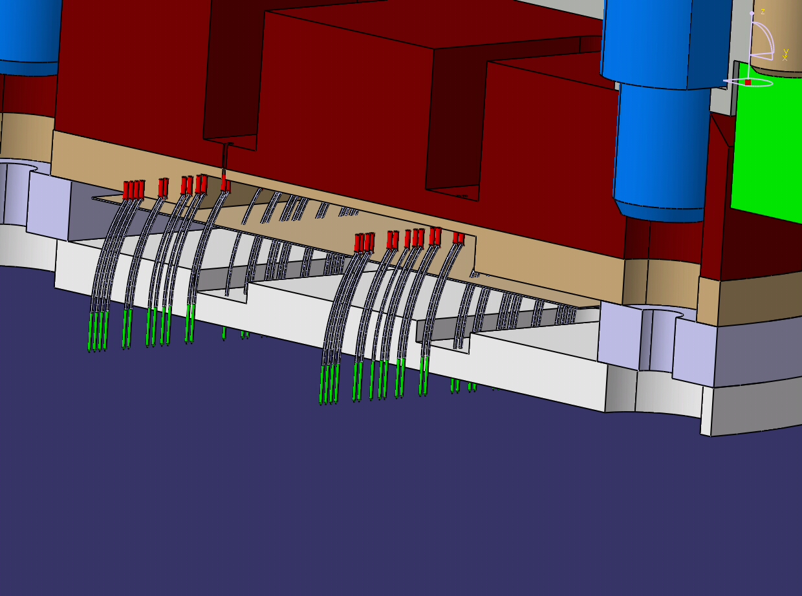
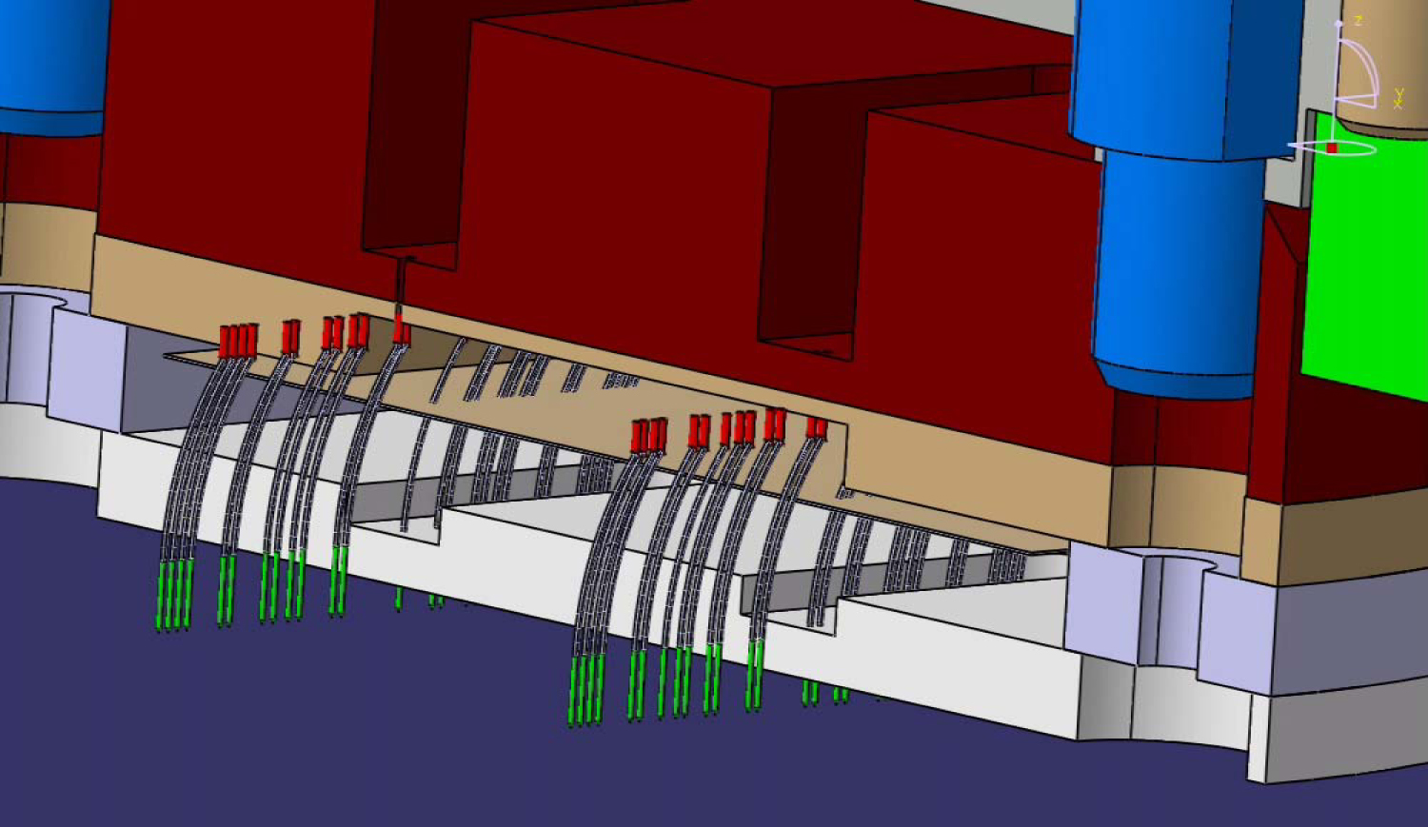
Vertical Probe Head
PROBES
Upper Die
Spacer
Lower Die

Slide 5
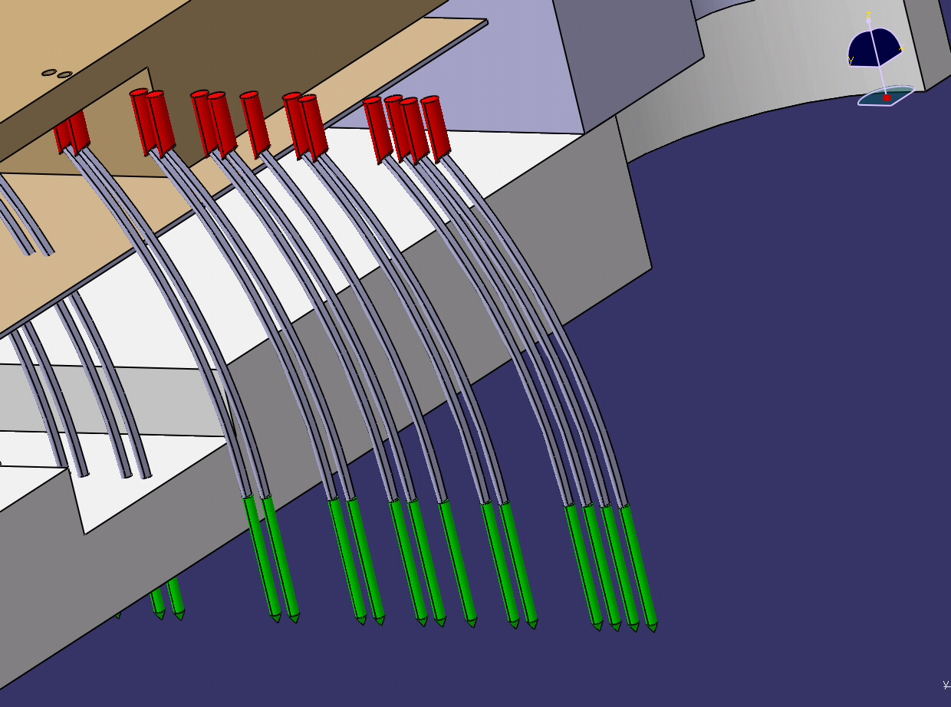
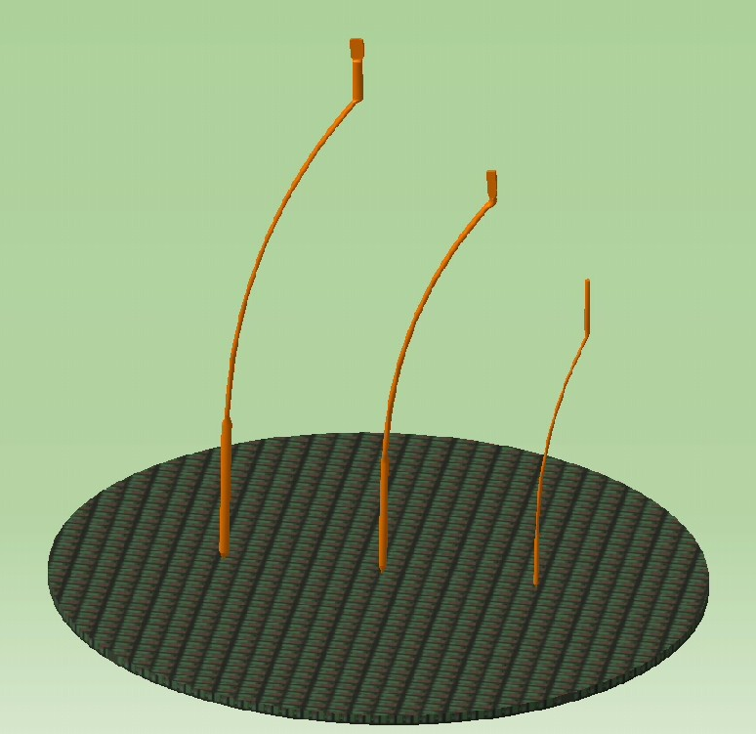
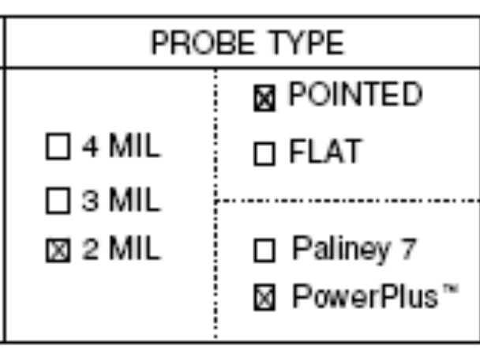
Probe Wires
Standard
4mils
3 mils
Enhanced 2 mils

Slide 6
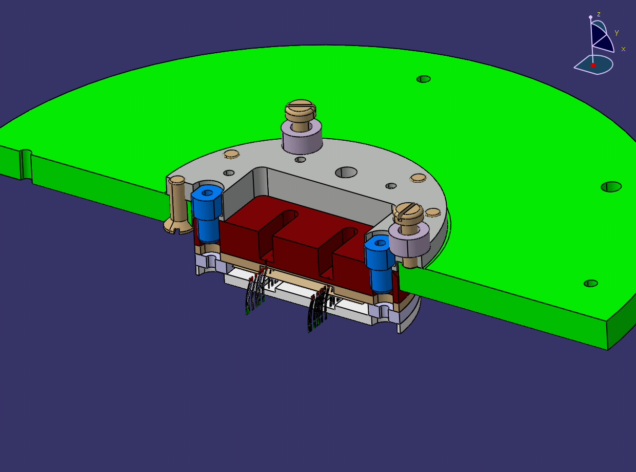
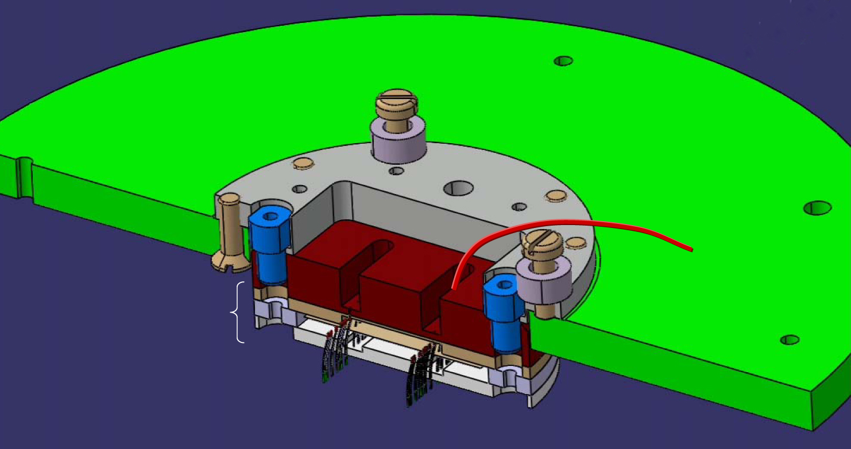
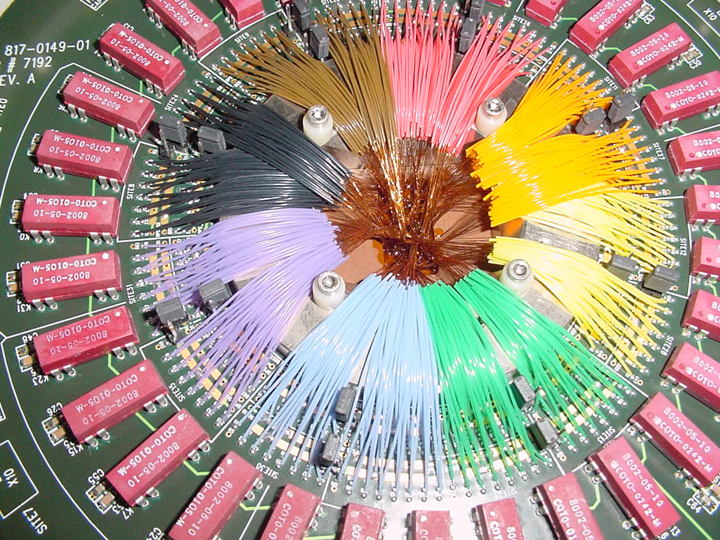
Hand Wired Vertical Card
PCB
Holder Ring or Stiffener
Wire
Space Die
Probe Head
Wired picture

Slide 7
Hand Wired Vertical Card
PCB must be countered in center
Have Space Die
Use Holder Ring/ Stiffener to hold the PH and PCB
Use wires to make electrical connection from PH with the PCB
Must have Solder Pads and CH

Slide 8
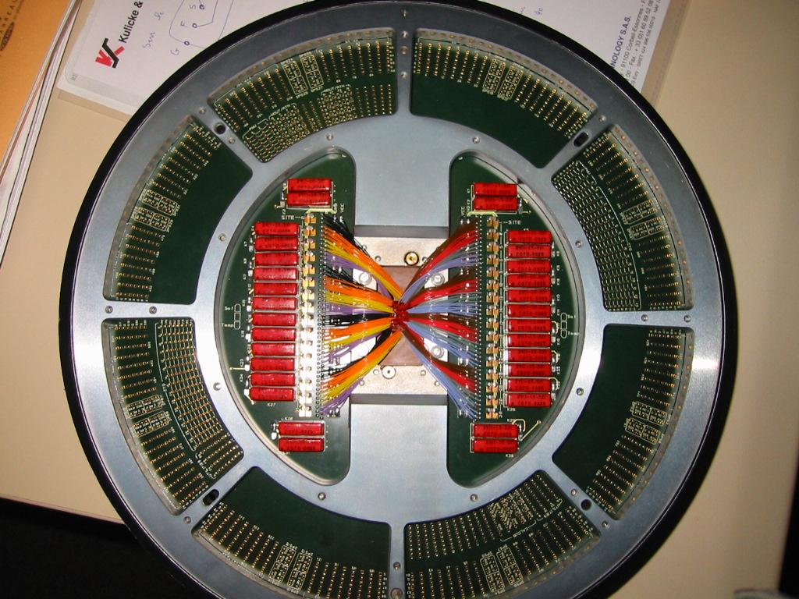
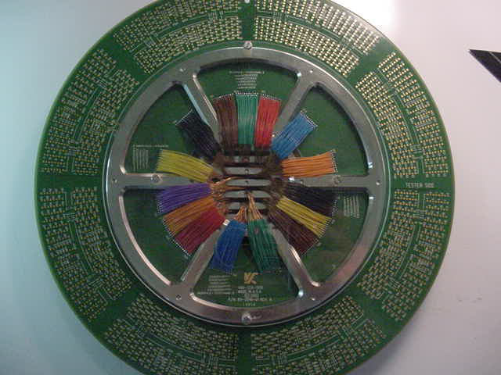
Example of Complex Stiffener Design:
Combo Stiffener + Space Die Holder

Slide 9
Wired Space Transformers Summary
Uses Wire to Translate the Electrical Path from the Head to the PCB
Works Best for Lower Point Counts <2000
Can use Generic PCBs
Lower Costs
Field Replaceable Heads
SV Factory Replaceable Probes

Slide 10
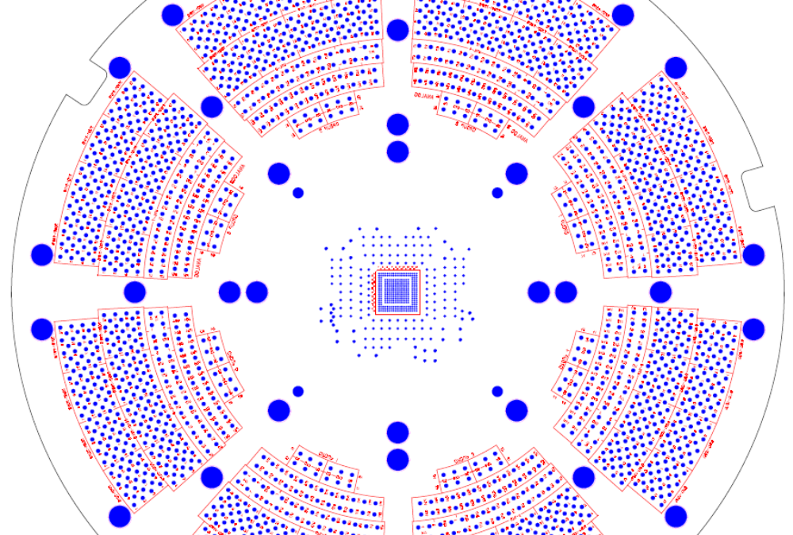
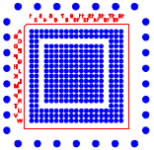
Rigid (SV Substrate/ CS Substrate)
PCB don’t have to counter bore

Slide 11
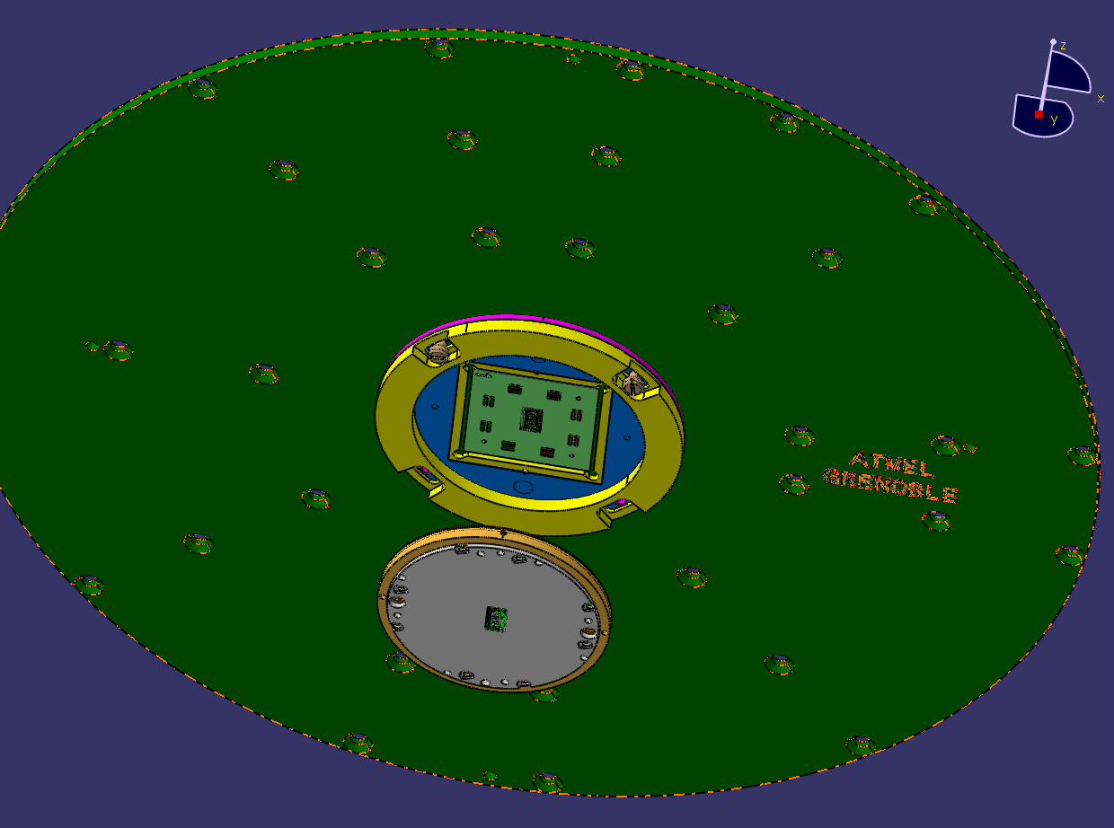
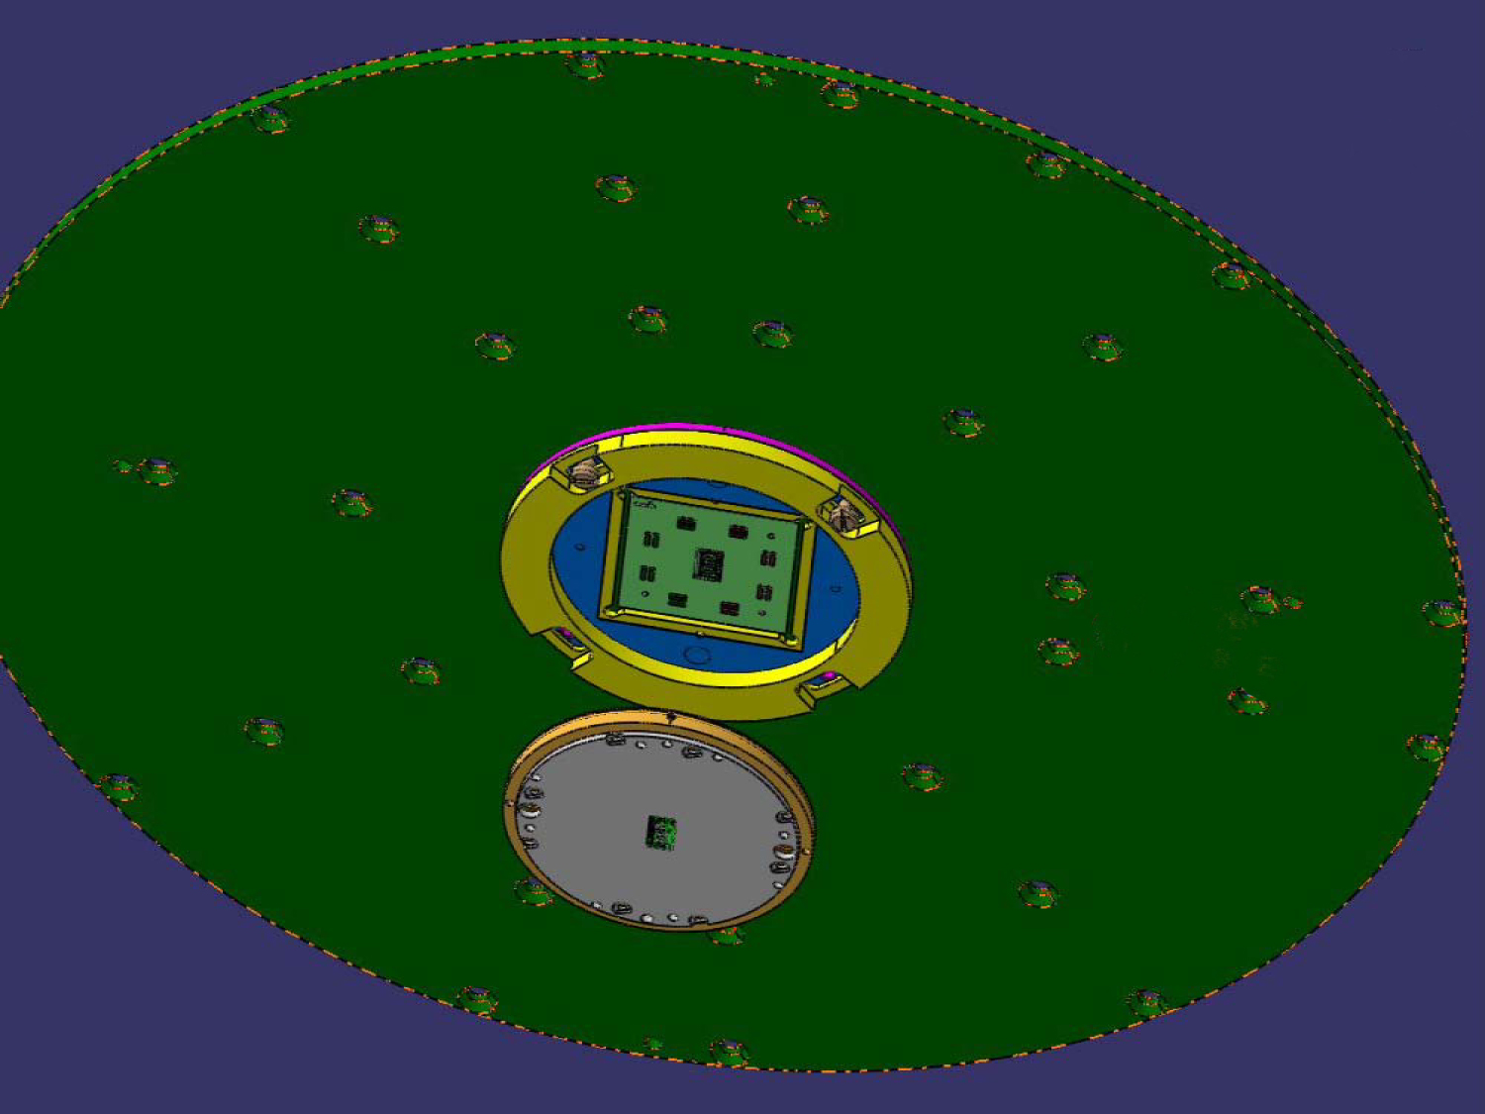
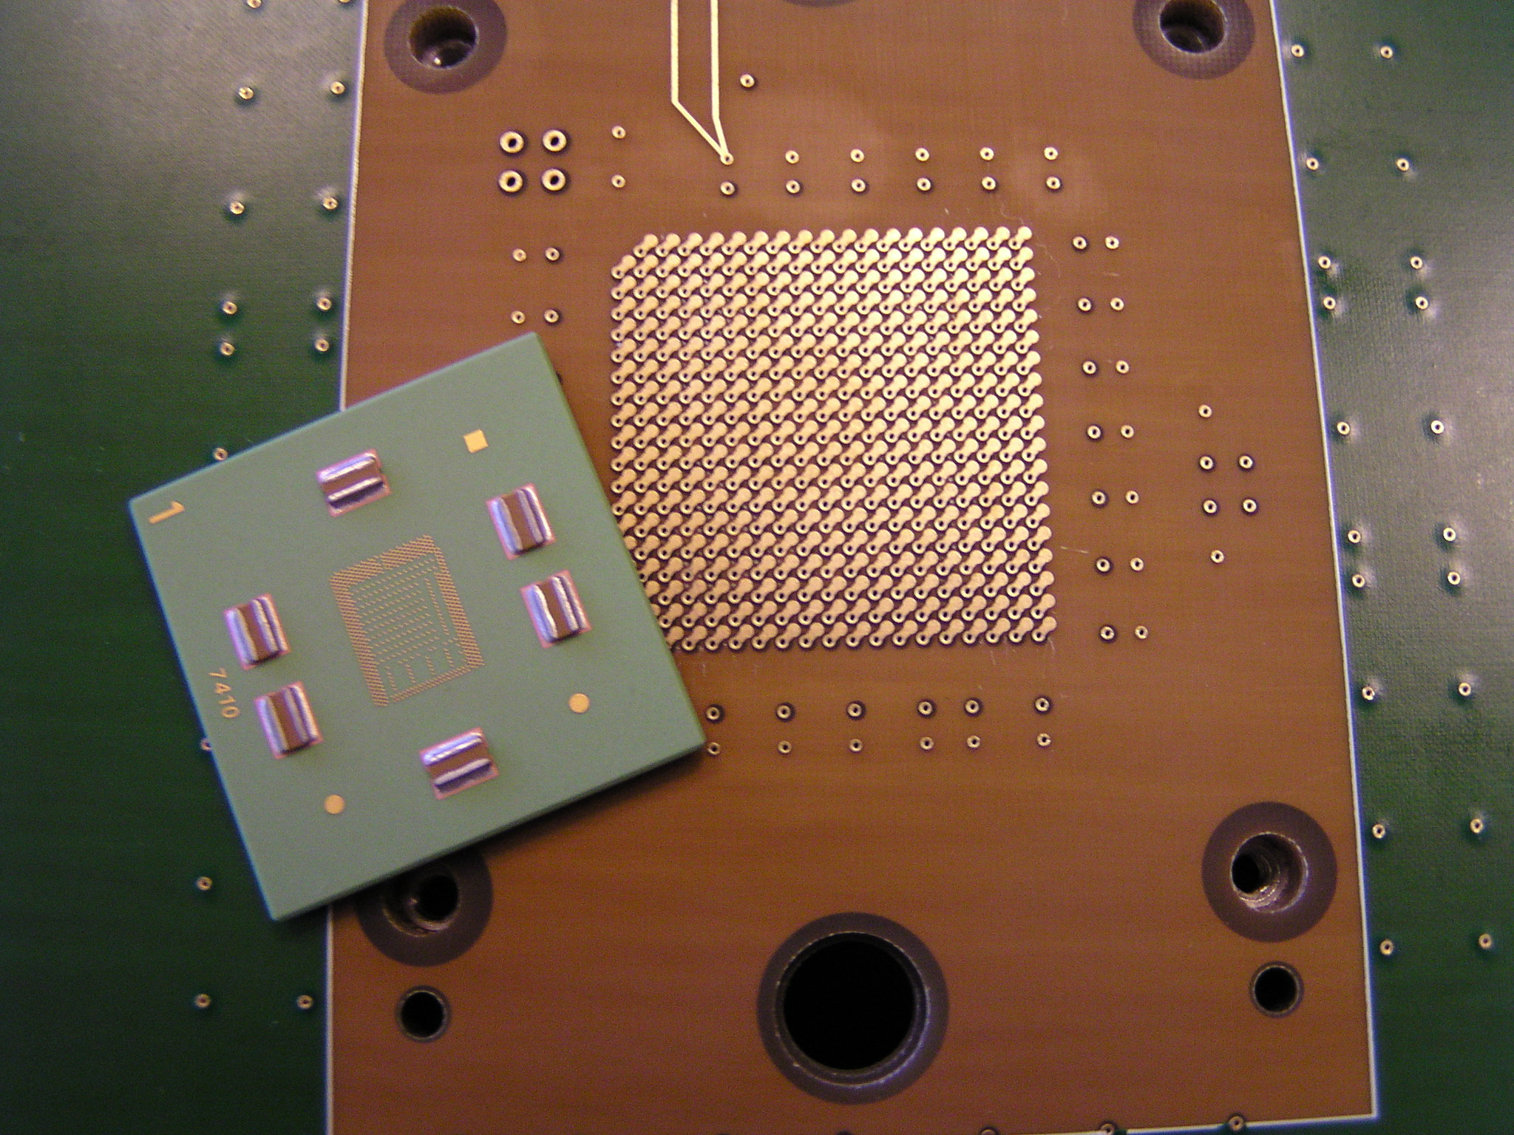
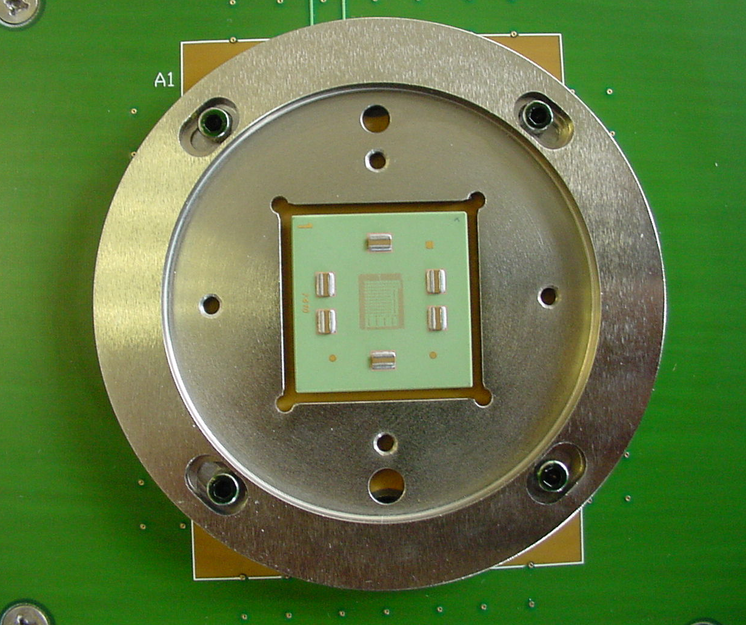
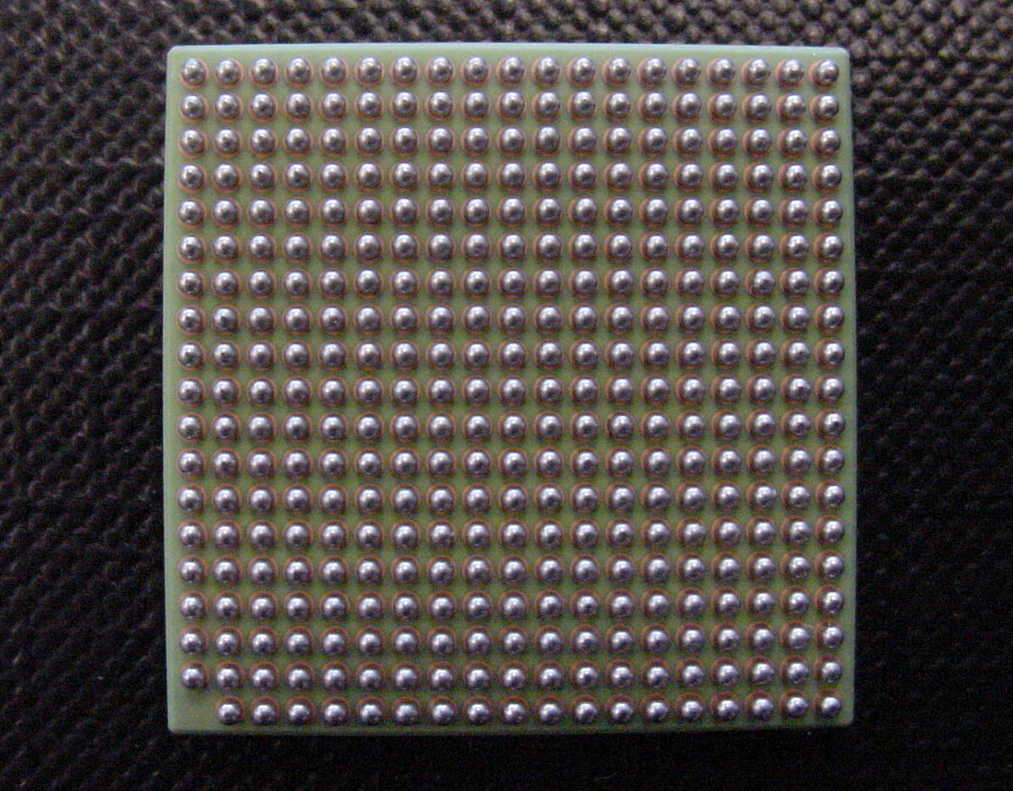
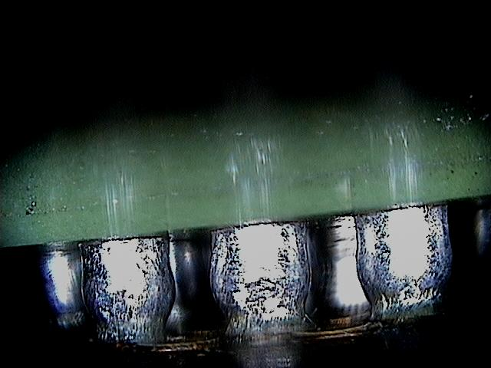
Rigid (SV Substrate/ CS Substrate)
Substrate (MLC, MLO, LTCC…)
Probe Head

Slide 12
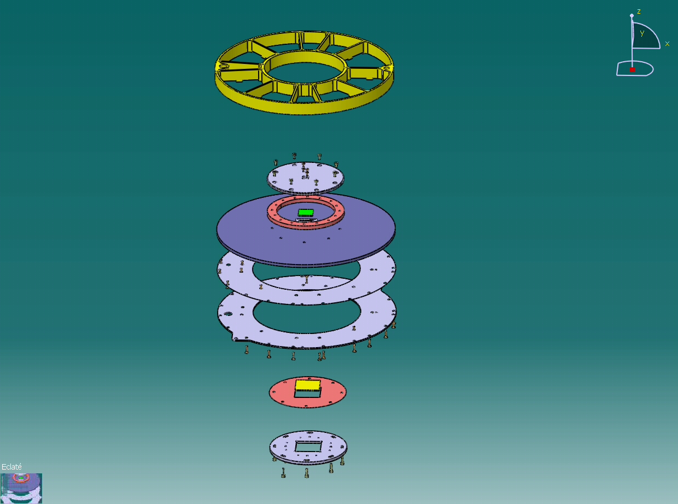
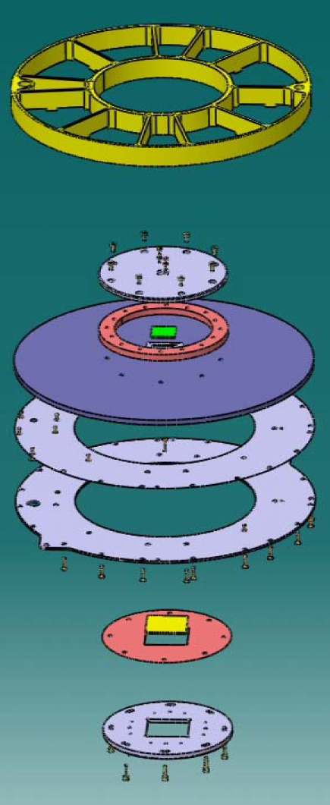
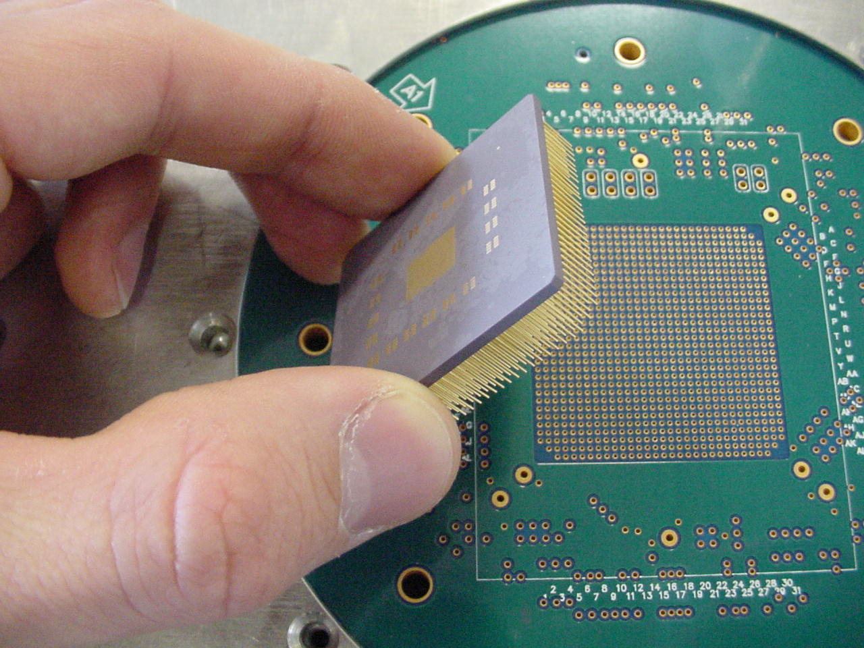
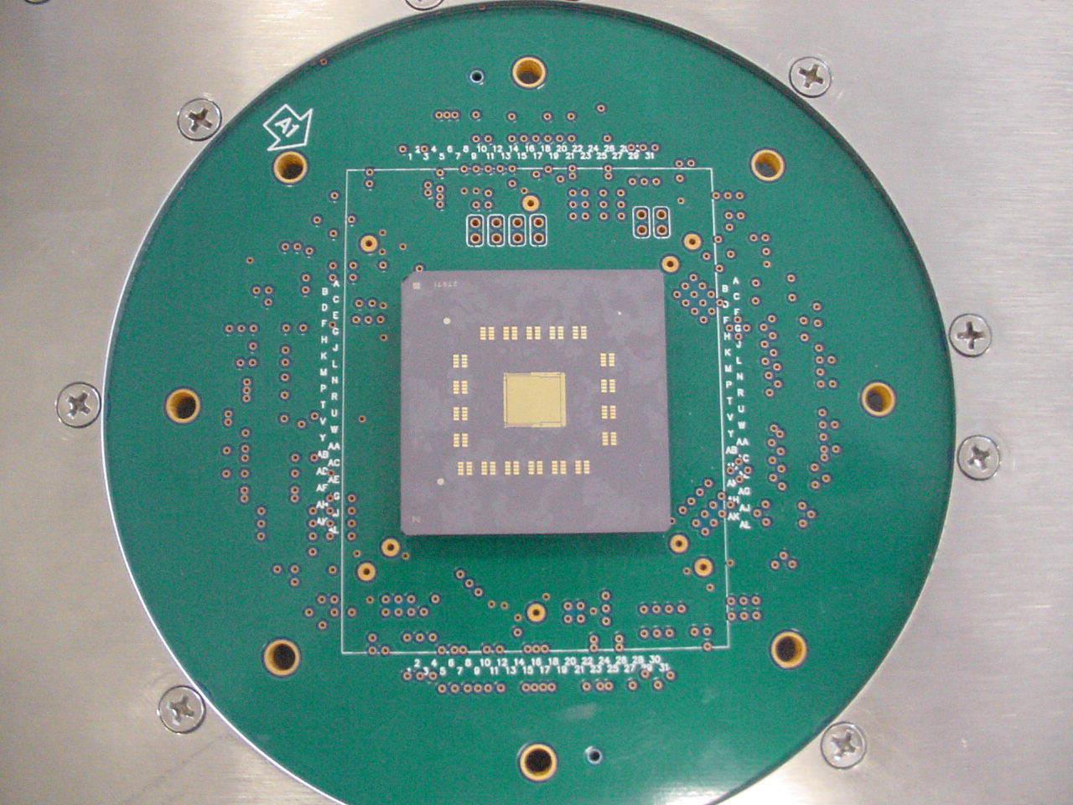
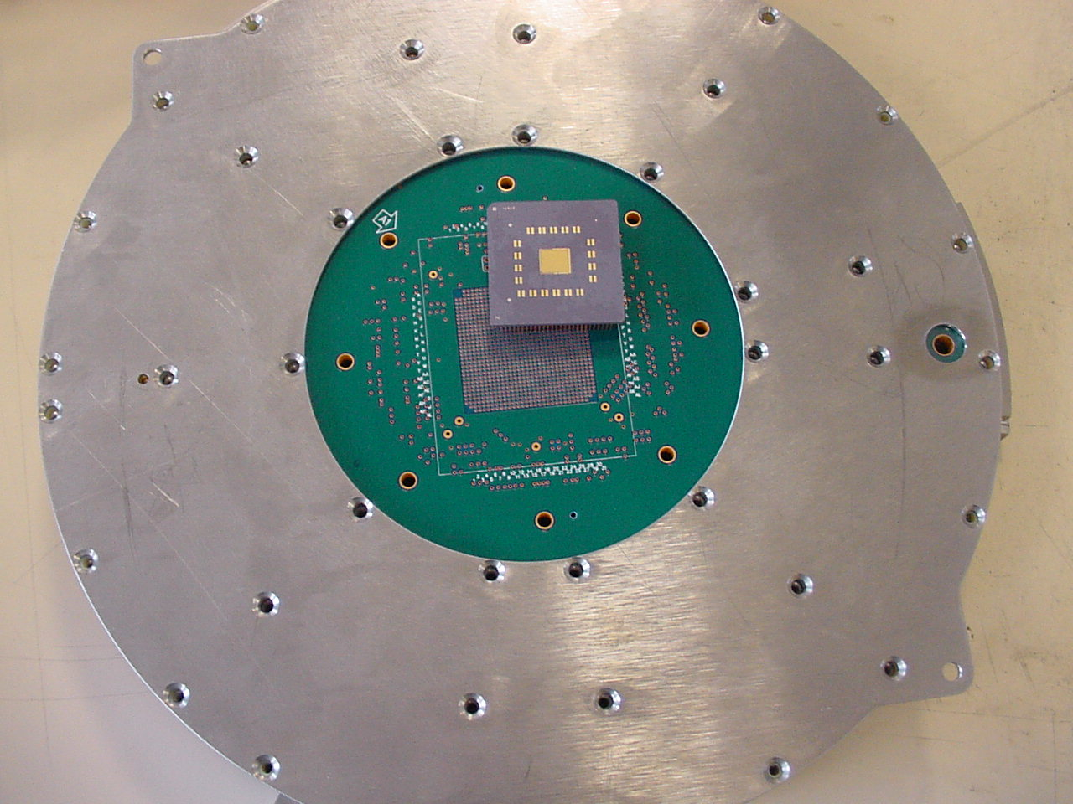
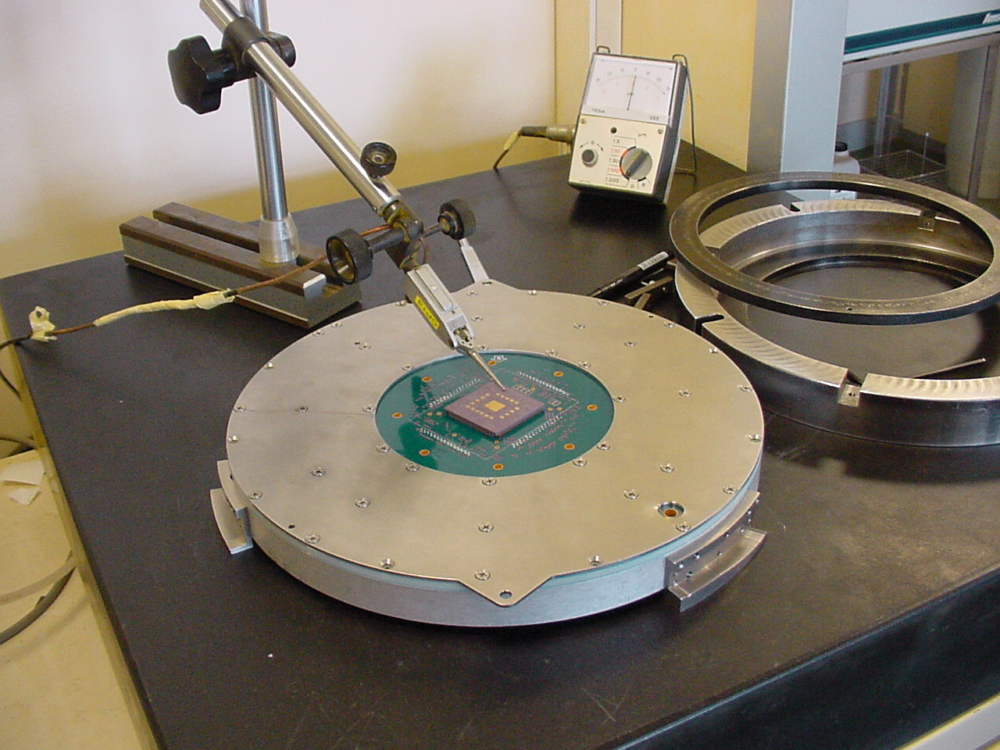
Rigid (SV Substrate/ CS Substrate)
1
3
2
4

Slide 13
Rigid (SV Substrate/ CS Substrate) Summary
Uses a Rigid Substrate to Translate the Electrical Path from the Head to the PCB
Better electrical performance
Higher point counts >1000
Must have custom PCB
Probe depth is fixed by the thickness of the assembly
Long design cycle
Moderate to high cost
Short electrical paths possible

